Slide 1
How to write programs
The secret of “programmers’ way of thinking”

Slide 2

What’s “programmers’ way of thinking”?
*My personal opinion

Slide 3
Let’s take an example
Create a program which asks the user for the number of minutes (integer) and outputs the given time span in format Hours:Minutes
Example:
Input: 512
Output: 8:32

Slide 4

Read and understand the conditions of a puzzle
Are you sure you understand what the program should do?
It’s not about how to implement it (or can you do it at all) - it’s really only about what we want to get in the end (as users of the program)
Input and output examples are helpful
If conditions are not clear or complete - ask questions
Sometimes companies give tasks with incomplete conditions for interviews - to see how good you are at understanding the task and asking the right questions
Conditions can be badly-worded
Focus on the question “What?” instead of “How?” (or “Why?”)

Slide 5
In our example:
The program should:
Get a number from user
Convert it to two other numbers
Print the two resulting numbers

Slide 6

Decompose the task
How to eat an elephant?

Slide 7
Decompose the task
… piece by piece

Slide 8
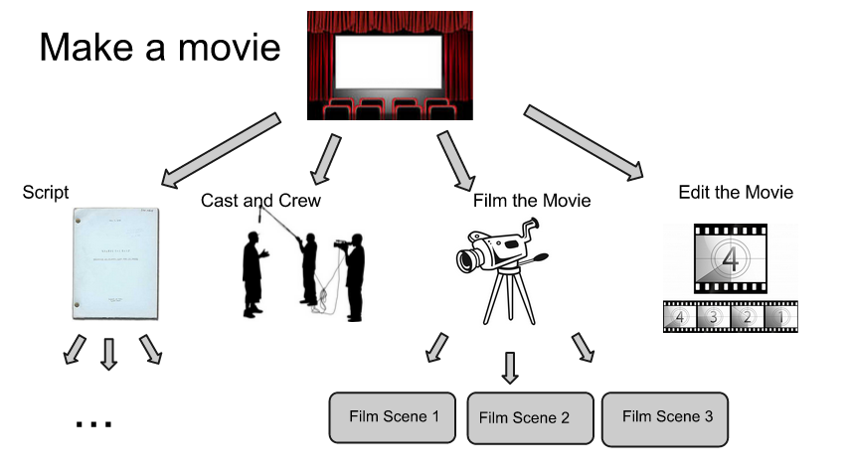
Decompose the task
Divide the task to a logical subtasks
Divide the subtasks even further until it’s clear
How to implement each subtask in Python
How to phrase the question like “How to <your subtask here> in Python”

Slide 9
In our example:
Get the number of minutes from a user
Show prompt in the command line
Read the value from the command line
Store the value in a variable (x)
Calculate the number of hours
Calculate the quotient of division of the x value by 60
Store the result in a variable hours
Calculate the number of minutes without hours
Calculate the remainder of division of the x value by 60
Store the result in a variable minutes
Print the result
Create the string of the format “hours:minutes”
Print the string to the command line
512 = 60 * 8 + 32
x = 60 * hours + minutes

Slide 10
Finally, it’s coding time
# Show prompt in the command line
print('Please enter the number of minutes')
# Read the value from the command line and store it in a variable
x = input()
# Calculate the quotient of division of the value by 60 and store...
hours = x // 60
# Calculate the remainder of division of the value by 60 and store...
minutes = x % 60
# Create the string of the format “hours:minutes”
output = hours + ':' + minutes
# Print the string to the command line
print(output)

Slide 11

But it’s not over yet
Run the program
Traceback (most recent call last):
File "/home/grafov/Desktop/slides/Lesson2-Interactive-programs/code/test.py", line 6, in <module>
hours = x // 60
TypeError: unsupported operand type(s) for //: 'str' and 'int'
Fix the errors
Run again
Traceback (most recent call last):
File "/home/grafov/Desktop/slides/Lesson2-Interactive-programs/code/test.py", line 10, in <module>
output = hours + ':' + minutes
TypeError: unsupported operand type(s) for +: 'int' and 'str'
...

Slide 12
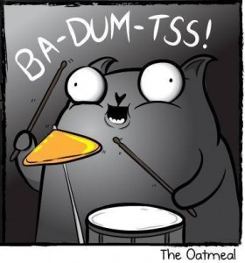
Testing
A software tester walks into a bar.
Orders a beer.
Orders ten beers.
Orders 2.15 billion beers.
Orders -1 beers.
Orders a nothing.
Orders a cat.
Tries to leave without paying.

Slide 13
In our example:
What are the edge cases?
What if user enters:
Negative numbers
Text
Zero
Nothing
What should the program do?
Do we really have to handle edge cases?
Sometimes input is verified already
Sometimes crashing is fine
If program behavior is incorrect - go back to coding
The more experienced you are, the earlier these questions pop up.
Ideally - when you are understanding the task and asking questions

Slide 14
Even better example
Write a program, which asks the user for a year and determines, if that year is a leap year (the one with 366 days) or not.
We found out the formula: a leap year’s number is either a multiple of 4, but not a multiple of 100, or a multiple of 400
We somehow managed to make code out of it:
if n % 4 == 0 and n % 100 != 0 or n % 400 == 0:
So what would be the first numbers to check, that our program generally works correctly (positive test-cases)?
Check for a number, which fulfills only the first condition: multiple of 4, but not a multiple of 100 - number 4 or 120 would work
Check for a number, which fulfills the second condition: multiple of 400 - number 400 or 1200 would work

Slide 15
In programming 75% of time is spent on thinking and 25% - on coding
*My personal estimation

